Slide 1
Two Player Game Playing through Adversarial Search
In this chapter we cover competitive environments, in which the agents’ goals are in conflict, giving rise to adversarial search problems—often known as games.
We begin with a definition of the optimal move and an algorithm for finding it. We then look at techniques for choosing a good move when time is limited. Pruning allows us to ignore portions of the search tree that make no difference to the final choice, and heuristic evaluation functions allow us to approximate the true utility of a state without doing a complete search.

Slide 2
GAME TREE
The initial state, ACTIONS function, and RESULT function define the game tree for the game—a tree where the nodes are game states, and the edges are moves. Figure 5.1 shows part of the game tree for tic-tac-toe.
From the initial state, MAX has nine possible moves. Play alternates between MAX’s placing an X and MIN’s placing an O until we reach leaf nodes corresponding to terminal states such that one player has three in a row, or all the squares are filled.
The number on each leaf node indicates the utility value of the terminal state from the point of view of MAX; high values are assumed to be good for MAX and bad for MIN (which is how the players get their names).

Slide 3
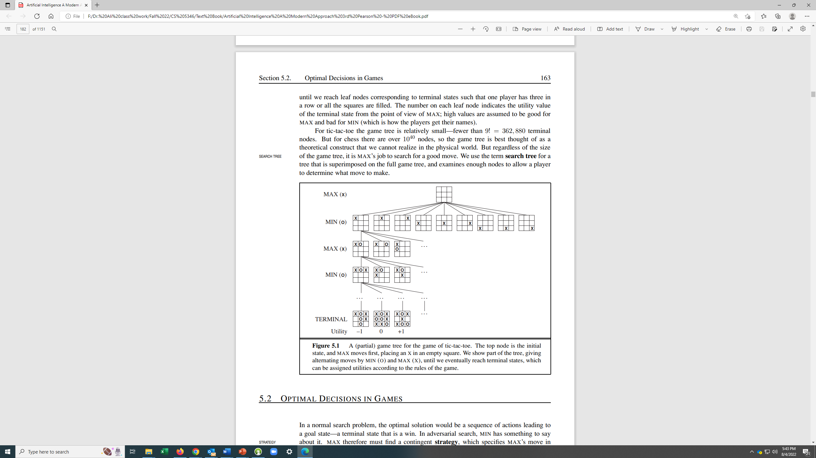

Slide 4
Size of Game Tree
For tic-tac-toe, the game tree is relatively small—fewer than 9! = 362, 880 terminal nodes. But for chess there are over 10power40 nodes, so the game tree is best thought of as a theoretical construct that we cannot realize in the physical world. But regardless of the size of the game tree, it is Player’s job to search for a good move.

Slide 5
We begin with a definition of the optimal move and an algorithm for finding it. We PRUNING then look at techniques for choosing a good move when time is limited. Pruning allows us to ignore portions of the search tree that make no difference to the final choice, and heuristic evaluation functions allow us to approximate the true utility of a state without doing a complete search.
We first consider games with two players, whom we call MAX and MIN for reasons that will soon become obvious. MAX moves first, then they take turns until the game ends. At the end of the game, points are awarded to the winning player and penalties are given to the loser. A game can be formally defined as a kind of search problem with the following elements:
S0: The initial state specifies how the game is set up at the start.
• PLAYER(s): Defines which player has the move in a state.
• ACTIONS(s): Returns the set of legal moves in a state.
• RESULT(s, a): The transition model defines the result of a move.
TERMINAL TEST • TERMINAL-TEST(s): A terminal test, which is true when the game is over and false otherwise.
TERMINAL STATES The States where the game has ended are called terminal states.
• UTILITY(s, p): A utility function (also called an objective function or payoff function): It can be applied to the terminal state of the game, and it gives the numerical value of the outcome of the game. The final numeric value for a game that ends in terminal state s for a player p. It could be +1, 0, or -1 in games like Tic-tac Toe, chess etc. It could be from 0 to +192 in the game of Backgammon.

Slide 6
Optimal Decisions in Games Very Early (First Version) Intelligent Systems
Even a simple game like tic-tac-toe is too complex for us to draw the entire game tree on one page, so we will switch to the trivial Hypothetical game in Figure 5.2.
The possible moves for MAX at the root node are labeled a1, a2, and a3. The possible replies to a1 for MIN are b1, b2, b3, and so on.
This particular game ends after one move each by MAX and MIN. (In game parlance, we say that this tree is one move deep, consisting of two half-moves, each of which is called a ply.) The utilities of the terminal states in this game range from 2 to 14
In this type of the game the depth of the tree is short enough to see the outcome of the game for a player in the amount of time the player has to make a move.

Slide 7
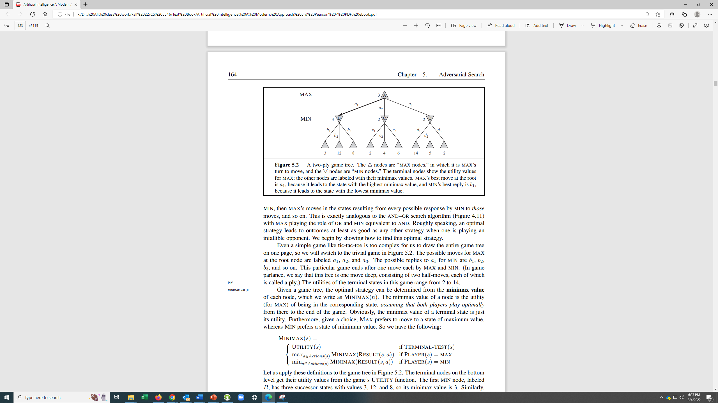

Slide 8
Finding Solution by MinMax Algorithm
MINMAX algorithm A Simple Descriptive Definition
The minimax algorithm computes the minimax decision from the current state.
It uses a simple recursive computation of the minimax values of each successor state, directly
implementing the defining equations. The recursion proceeds all the way down to the leaves
of the tree, and then the minimax values are backed up through the tree as the recursion
unwinds. For example, in Figure 5.2, the algorithm first recurses down to the three bottom left nodes and uses the UTILITY function on them to discover that their values are 3, 12, and
8, respectively. Then it takes the minimum of these values, 3, and returns it as the backed up value of node B. A similar process gives the backed-up values of 2 for C and 2 for D.
Finally, we take the maximum of 3, 2, and 2 to get the backed-up value of 3 for the root node.

Slide 9
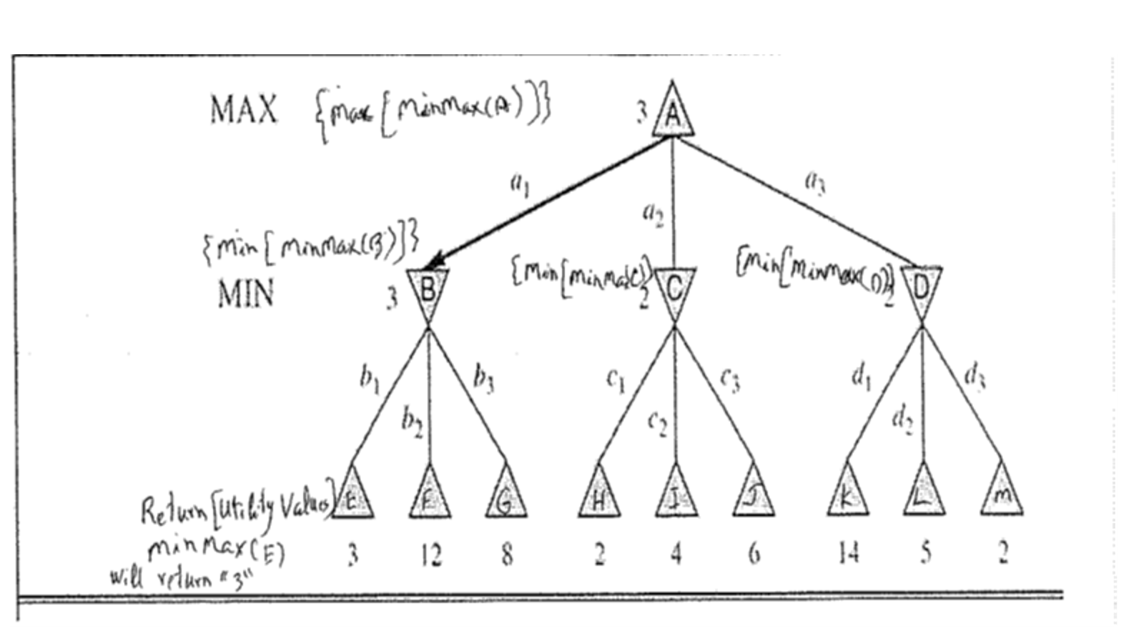
{MAX [MinMax (A)]}
{MIN[MinMax(B)]}
{MIN[MinMax(C)]}
{MIN[MinMax(D)]}
2
2
{MAX [ MinMax(E)]}
Return[Utility Values]
Will return “3”

Slide 11
Game Strategies in Intelligent Techniques. Second Version
The technique embodied in this program #1 does not appear to meet any of our requirements for a good AI technique. Let's see if we can do better. First human player use strategies. An example is given below:
Initial Strategy
Move to corner square
Move to middle square
Move Strategy
I am winning – go for that
My opponent winning – block opponent
Rest – call Make1-corner square strategies
Middle square – call Make 2-non-corner square strategies

Slide 12
Let us incorporate some intelligent techniques in the Program #2 below:
Program 2
Data Structures
Board A nine-element vector representing the board, as described for Program
I . But instead of using the numbers 0, I , or 2 in each element,
we store 2 (indicating blank), 3 (indicating X), or 5 (indicating O).
Turn An integer indicating which move of the game is about to be played;
1 indicates the first move, 9 the last.
The Algorithm
The main algorithm uses four sub procedures:
Make2 Returns 5 if the center square of the board is blank, that is, if Board[5]
= 2. Otherwise, this function returns any blank non corner square
( 2, 4, 6, or 8).
Make1 Returns corner square (1,3,7, or 9)- Corner Squares.
Posswin(p) Returns 0 if player p cannot win on his next move; otherwise, it
returns the number of the square that constitutes a winning move.
This function will enable the program both to win and to block the
opponent's win. Posswin operates by checking, one at a time, each
of the rows, columns, and diagonals. Because of the way values are
numbered, it can test an entire row (column or diagonal) to see if it

Slide 13
is a possible win by multiplying the values of its squares together.
If the product is 18 (3 x 3 x 2), then X can win. If the product is 50
(5 x 5 x 2), then 0 can win. If we find a winning row, we determine
which element is blank and return the number of that square.
Go(n) Makes a move in square n. This procedure sets Board[n] to 3 if
Turn is odd, or 5 if Turn is even. It also increments Turn by one.
3
3
2
5
 | 5
 |  | 2

Slide 14
Algorithm for Intelligent System Playing Tic-Tac-Toe
Initialize all nine squares to 2.
i=1
Player i and i+1 chose Make 2 or Make 1 and call them alternately.
After the third move each player calls ‘possiblewin’ to check if he is winning to make a winning move or the opponent is winning to block him. Take an action accordingly.
If possiblewin does not give winning move, then call Make 1 or Make 2 which ever has been selected by the player.
Process continue with players alternate, till one player wins or the game is draw.

Slide 15
X 1. Make 2
O 2. Make 1
X 3. Make 2, If Board [2] is empty Go [2]
O 4. If Possiblewin (x) is not 0 then Go(Possiblewin (x)),
else Go (Make1)
X 5. If Possiblewin(O) is not 0 then Go(Possiblewin(O),
else Go (Make 2).
O 6. If Possiblewin (x) is not 0 then Go(Possiblewin (x)),
else Go (Make1)
X 7. If Possiblewin(O) is not 0 then Go(Possiblewin(O),
If Possiblewin (x) is not 0 then Go(Possiblewin (x)),
O 8. If Possiblewin (x) is not 0 then Go(Possiblewin (x)),
else Go (Make1)
X 9. If Possiblewin(O) is not 0 then Go(Possiblewin(O),
If Possiblewin (x) is not 0 then Go(Possiblewin (x)),
All Squares are full. The Game is Draw
1 O₂(5) | 2 X₃(3) | 3 X₇(3)
4 X₅(3) | 5 X₁(3) | 6 O₆(5)
7 O₈(5) | 8 O₄(5) | 9 X₉(3)

Slide 16
EXERCISE TO BE DONE BY STUDENTS
Steps if X moves first and starts with Make1
1 X₁(3) | 2 O₄(5) | 3 X₇(3)
4 X₉(3) | 5 O₂(5) | 6 O₈(5)
7 O₆(5) | 8 X₅(3) | 9 X₃(3)

Slide 17
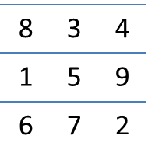
Comments on Program #2
This program is not quite as efficient in terms of time as the first one since it has to
check several conditions before making each move. But it is a lot more efficient in
terms of space. It is also a lot easier to understand the program's strategy or to change the strategy if desired. But the total strategy has still been figured out in advance by the programmer. Any bugs in the programmer's tic-tac-toe playing skill will show up in the program's play. And we still cannot generalize any of the program's knowledge to a different domain, such as three-dimensional tic-tac-toe.
Very importantly, it takes too much search time to check every row and column.
Improvements in Program #3:
Use of Magic Square:

Slide 18
Intelligent Systems-Version Three
Program #2 is good, but it requires searching and testing for all rows, columns, and diagonals, which makes it inefficient. We will use magic squares to avoid searching. It is done in the Program #3 below:
Similarities with Program #2:
Data Structures
Board A nine-element vector representing the board, as described for the Program
I . But instead of using the numbers 0, I, or 2 in each element,
we store 2 (indicating blank), 3 (indicating X), or 5 (indicating O).
Turn An integer indicating which move of the game is about to be played;
1 indicates the first move, and 9 the last.
The Algorithm
The main algorithm uses three sub-procedures:
Make2 Returns 5 if the center square of the board is blank, that is, if Board[5]
= 2. Otherwise, this function returns any blank non-corner square
( 2, 4, 6, or 8).
Make1 Returns corner square (1,3,7, or 9)- Corner Squares.

Slide 19
Differences with program #2:
1. The numbering of the board produces a magic square: all the rows,
columns and diagonals sum to 15. We again represent the board as a nine-element vector, but this time we assign board positions to vector elements as follows Using magic squares, shown below:
2. A new Possible win function is used which is explained through an example below in the next few PowerPoint slides. This means that we can simplify the process of
checking for a possible win. In addition to marking the board as moves are made, we
keep a list, for each player, of the squares in which he or she has played. To check for a
possible win for one player, we consider each pair of squares owned by that player and
compute the difference between 15 and the sum of the two squares. If this difference
is not positive or if it is greater than 9, then the original two squares were not collinear
and so can be ignored. Otherwise, if the square representing the difference is blank,
a move there will produce a win.
An Example Is given starting the next page:

Slide 20
Player → O₁
Action → 1
Initial Step O Calls make2 which assigns O₁ to central square ‘5’
8 | 3 | 4
1 | 5 O₁ | 9
6 | 7 | 2
Corner Center
X₁ O₁
5
____________________________________________________________
This is O’s Turn
The next Turn is for X

Slide 21
Player → X₁
Action → 1
X Calls make1 which assigns X₁ to Corner square ‘8’
8 X₁ | 3 | 4
1 | 5 O₁ | 9
6 | 7 | 2
Corner Center
X₁ O₁
8 5
____________________________________________________________
This is X’s Turn
Next Turn is for O

Slide 22
Player → O₂
Action → 2
O₂ Calls make2
8 X₁ | 3 O₂ | 4
1 | 5 O₁ | 9
6 | 7 | 2
Corner Center(non-Corner)
X₁ O_{1 ,} O₂
8 5 3
__________________________________________________________
This is O’s Turn
Next Turn is for X

Slide 23
8 X₁ | 3 O₂ | 4
1 | 5 O₁ | 9
6 | 7 X₂ | 2
Player → X₂
Action → 2
Corner Center(non-Corner)
X₁ X₂ O₁ O₂
8 , 7 5 , 3
(8,7) (5,3)
____________________________________________________________
X₂ =15 – (5+3) = 7
This is X’s Turn
Next Turn Is for O

Slide 24
8 X₁ | 3 O₂ | 4
1 | 5 O₁ | 9 O₃
6 | 7 X₂ | 2
Player → O₃
Action → 3
Corner Center(non-Corner)
X₁ X₂ O₁ O₂ O₃
8 , 7 5 , 3, 9
(8,7) (5,3),(5,9),(3,9)
____________________________________________________________
O₃ =15 – (8+7) = 0 ; 0 is out of bounds, So O uses make2 and moves 9
This is O’s Turn
Next Turn Is for X

Slide 25
8 X₁ | 3 O₂ | 4
1 X₃ | 5 O₁ | 9 O₃
6 | 7 X₂ | 2
Player → X₃
Action → 3
Corner Center
X₁ X₂ X₃ O₁ O₂ O₃
8 , 7, 1 5 , 3, 9
(8,7),(8,1),(7,1) (5,3),(5,9),(3,9)
____________________________________________________________
X₃ =15 – (5+3) = 7 ; 7 is already occupied
X₃ =15 – (3+9) = 3 ; 3 is already occupied
X₃ =15 – (5+9) = 1 ; X moves at 1
This is X’s Turn
Next Turn Is for O

Slide 26
8 X₁ | 3 O₂ | 4
1 X₃ | 5 O₁ | 9 O₃
6 O₄ | 7 X₂ | 2
Player → O₄
Action → 4
Corner Center(non-Corner)
X₁ X₂ X₃ O₁ O₂ O₃ O₄
8 , 7, 1 5 , 3, 9, 6
(8,7),(8,1),(7,1) (5,3),(5,9),(3,9),
(5,6),(3,6),(9,6)
_________________________________________
O₄ =15 – (8+7) = 0 ; 0 is out of range
O₄ =15 – (8+1) = 6 ; O moves to 6
O₄ =15 – (7+1) = 7 ; 7 is already occupied
So, O chooses 6
This is O’s Turn
Next Turn Is X

Slide 27
8 X₁ | 3 O₂ | 4 X₄
1 X₃ | 5 O₁ | 9 O₃
6 O₄ | 7 X₂ | 2
Player → X₄
Action → 4
Corner Center(non-Corner)
X₁ X₂ X₃ X₄ O₁ O₂ O₃ O₄
8 , 7, 1, 4 5 , 3, 9, 6
(8,7),(8,1),(7,1), (5,3),(5,9),(3,9),
(8,4),(7,4),(1,4) (5,6),(3,6),(9,6)
____________________________________________________________
X₄ =15 – (5+3) = 7 ; 7 is already occupied
X₄ =15 – (5+9) = 1 ; 1 is already occupied
X₄ =15 – (5+6) = 4 ; X chooses 4
So, X chooses 4 to block O’s win
This is X’s Turn
Next Turn Is O
X₄ =15 – (3+9) = 3 ; 3 is already occupied
X₄ =15 – (3+6) = 6 ; 6 is already occupied
X₄ =15 – (9+6) = 0 ; 0 is out of range

Slide 28
8 X₁ | 3 O₂ | 4 X₄
1 X₃ | 5 O₁ | 9 O₃
6 O₄ | 7 X₂ | 2 O₅
Player → O₅
Action → 5
Corner Center(non-Corner)
X₁ X₂ X₃ X₄ O₁ O₂ O₃ O₄
8 , 7, 1, 4 5 , 3, 9, 6
(8,7),(8,1),(7,1), (5,3),(5,9),(3,9),
(8,4),(7,4),(1,4) (5,6),(3,6),(9,6)
_____________________________________________________________
O₅ =15 – (8 +7) = 0 ; 0 is out of range
O₅ =15 – (8 +1) = 6 ; 6 is already occupied
O₅ =15 – (7 + 1) = 7 ; 7 is already occupied
Since only 2 is left, O₅ chooses 2
This is O’s Turn
O₅ = 2
The game is completed and it is a Draw.
O₅ =15 – (8 +4) = 3 ; 3 is already occupied
O₅ =15 – (7 +4) = 4; 4 is already occupied
O₅ =15 – (1 +4) = 10 ; 10 is out of range

Slide 29
Comments on Program #3
This comparison raises an interesting question about the relationship between the way
people solve problems and the way computers do. Why do people find the row-scan
approach easier while the number-counting approach is more efficient for a computer?
We do not know enough about how people work to answer that question completely.
One part of the answer is that people are parallel processors and can look at several
parts of the board at once, whereas the conventional computer must look at the squares
one at a time. Sometimes an investigation of how people solve problems sheds great
light on how computers should do so. At other times, the differences in the hardware
of the two seem so great that different strategies seem best. As we learn more about
problem solving both by people and by machines, we may know better whether the same representations and algorithms are best for both people and machines.

Slide 30
Imperfect Real-Time Decisions in Games Using Intelligent Methods Version #4
In Imperfect Real-Time Decisions in Games, the depth of tree is too large to see the outcome of the game. The simplest example is the game of Tic-Tac-toe. The tree is shown in the next slide. The following two steps are used these games.
Cut Off Search
Evaluation Functions

Slide 31
Cutting off search at the depth of ‘d’
We can cutoff tree at the depth of ‘d’. The depth d is chosen so that a move is selected within the allocated time.

Slide 32
IMPERFECT REAL-TIME DECISIONS Game-Continued
As stated in the previous slide, the program cut off the search tree at certain depth. But we cannot apply utility functions to cutoff state nodes because they are not at the outcome terminal nodes of the game.
So, we apply a heuristic evaluation function to the cutoff state nodes effectively turning nonterminal nodes into terminal leaves. Evaluation Function is the estimate of the utility function.
Characteristics of the Evaluation: Continued on the next slide

Slide 33
Characteristics of the Evaluation Function
First, the evaluation function should order the terminal states in the same way as the true utility function as it estimates it.: states that win must evaluate better than draws, which in turn must be better than losses. Otherwise, an agent using the evaluation function might err even if it can see ahead all the way to the end of the game.
Second, the computation must not take too long. (The whole point is to search faster.)
Third, for nonterminal states, the evaluation function should be strongly correlated with the actual chances of winning.

Slide 34
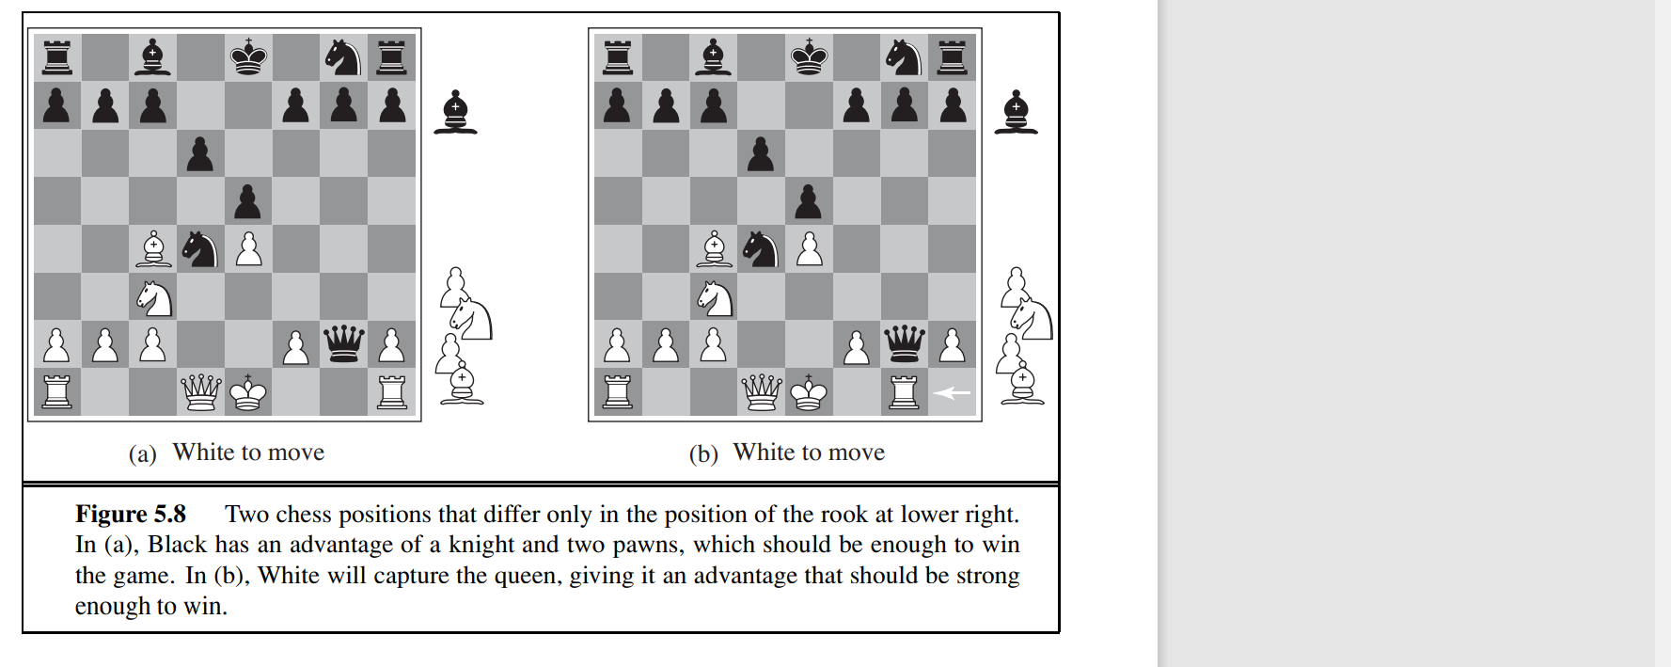

Slide 35
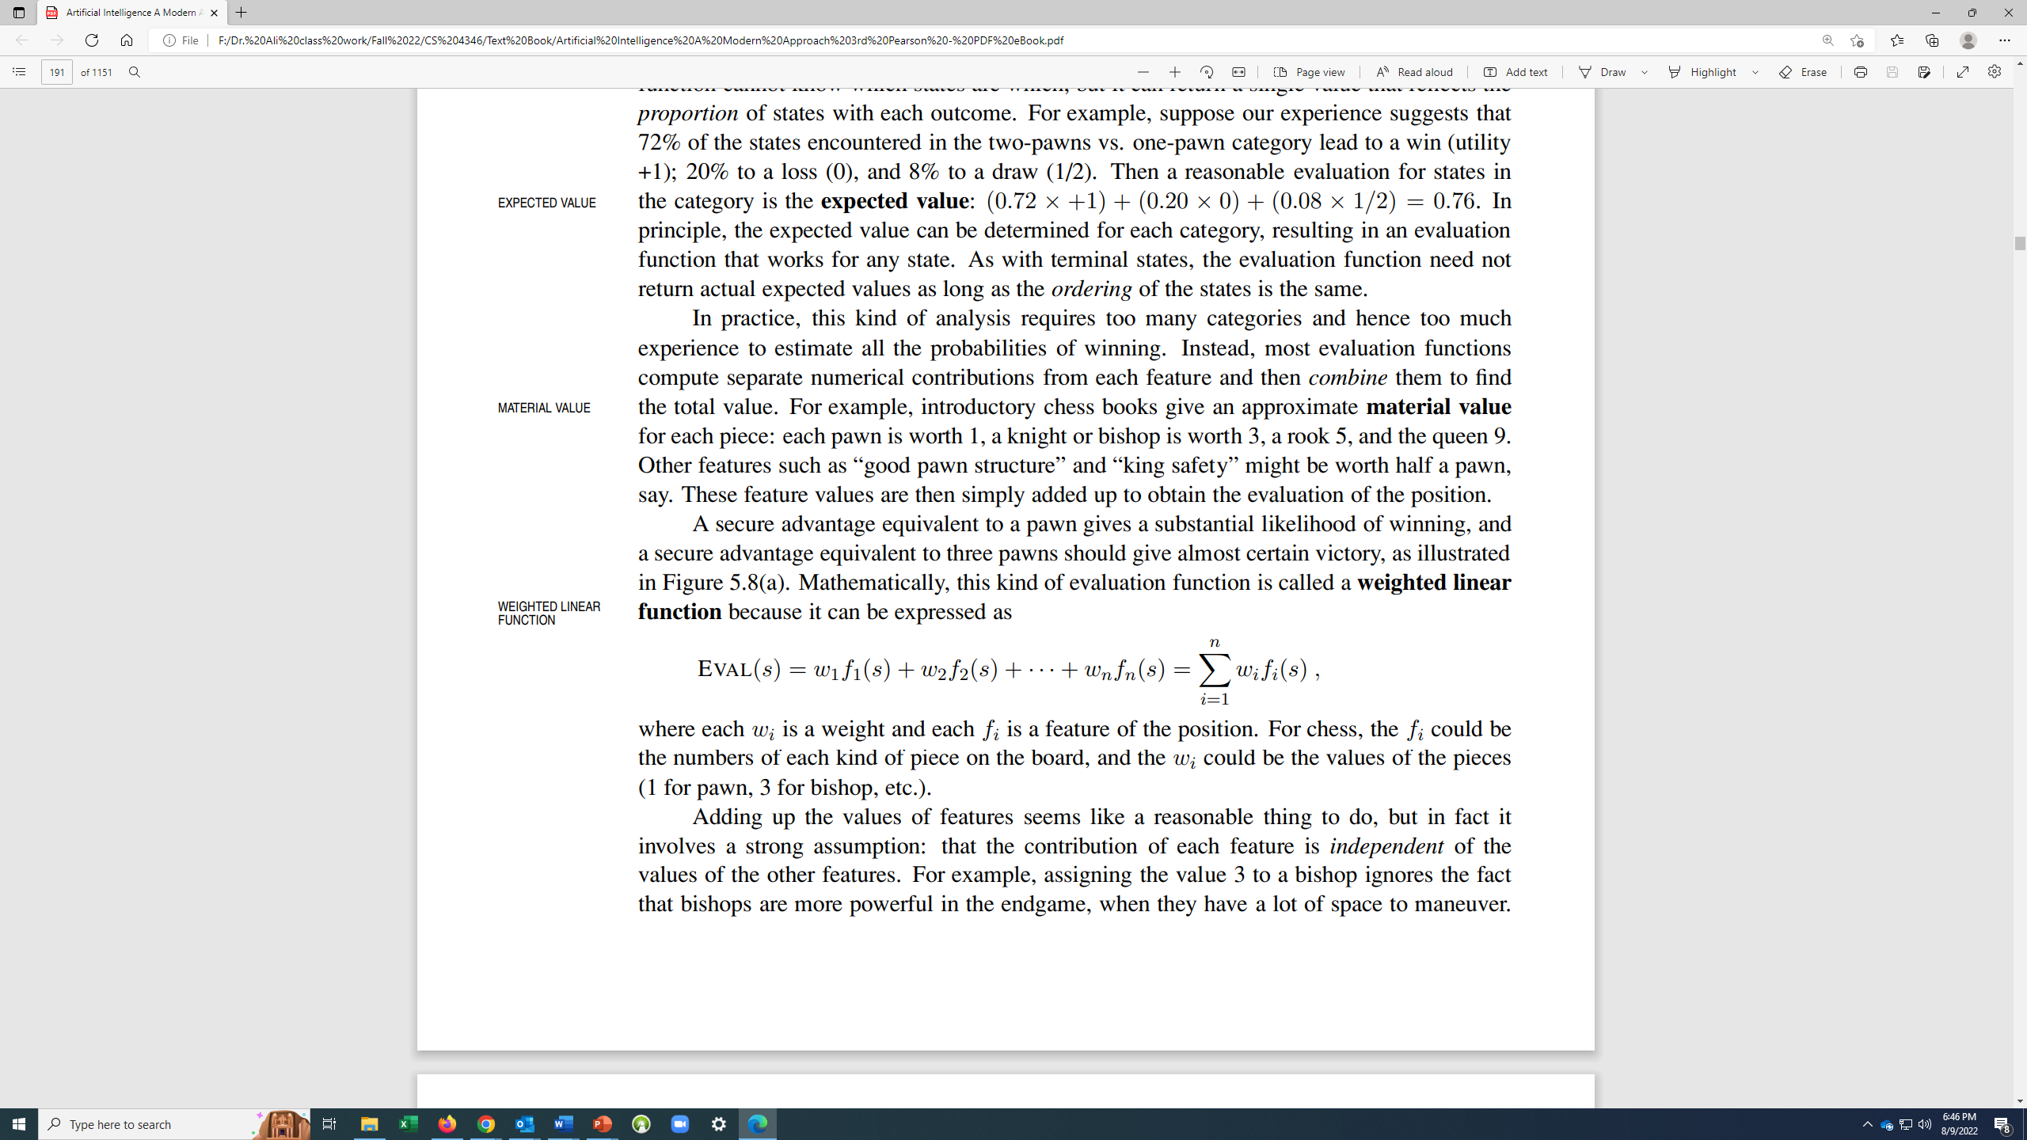
Evaluation Function
Most evaluation functions work by calculating various features of the state—for example, in chess, we would have features for the number of white pawns, black pawns, white queens, black queens, and so on. The features, taken together, define various categories or equivalence classes of states: the states in each category have the same values for all the features.
Most evaluation functions compute separate numerical contributions from each feature and then combine them to find MATERIAL VALUE the total value. For example, introductory chess books give an approximate material value for each piece: each pawn is worth 1, a knight or bishop is worth 3, a rook 5, and the queen 9. Other features such as “good pawn structure” and “king safety” might be worth half a pawn, say. These feature values are then simply added up to obtain the evaluation of the position.
Mathematically, this kind of evaluation function is called a weighted linear function because it can be expressed as:
where each wi is a weight and each fi is a feature of the position. For chess,
the fi could be the numbers of each kind of piece on the board, and the wi could be the values of the pieces (1 for pawn, 3 for bishop, etc.).

Slide 36
First a Hypothetical Examples

Slide 37
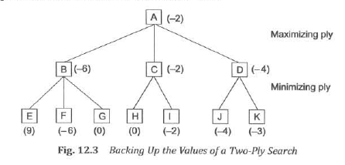

Slide 38
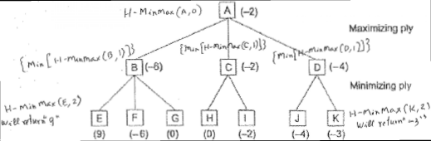
H – MinMax (A,0)
Maximizing ply
{Min[H – MinMax (D,1)]}
{Min[H – MinMax (C,1)]}
{Min[H – MinMax (B,1)]}
Minimizing ply
H – MinMax (E,2)
H – MinMax (K,2)
Will return “9”
Will return “-3”

Slide 39
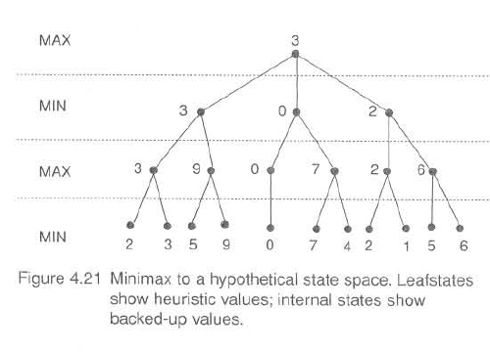

Slide 40
Real Example of Tic-Tac-Toe

Slide 41
The discussion of minimax, we present an application to tic-tac-toe, A slightly more complex heuristic is used, one that attempts to measure the conflict in the game. The heuristic takes a state that is to be measured, counts all winning lines open to MAX, and then subtracts the total number of winning lines open to MIN. The search attempts to maximize this difference. If a state is a forced win for MAX, it is evaluated as +∞; a forced win for MIN, as -∞. Diagrams below show this heuristic applied to several sample states.

Slide 42
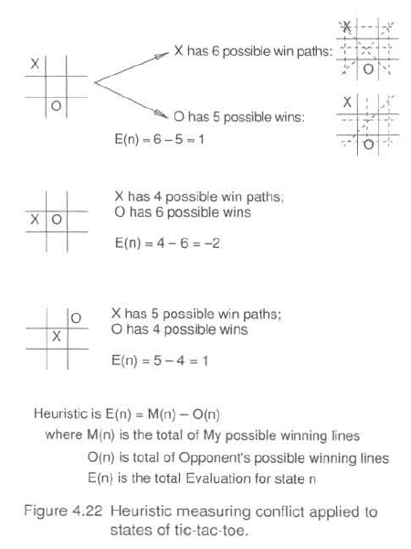

Slide 43
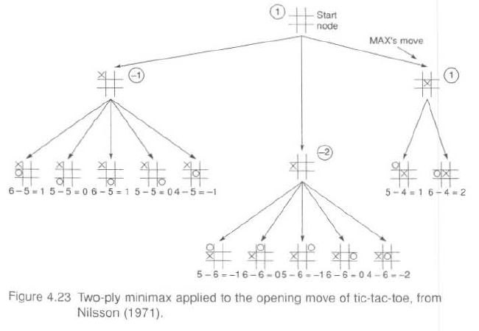

Slide 44
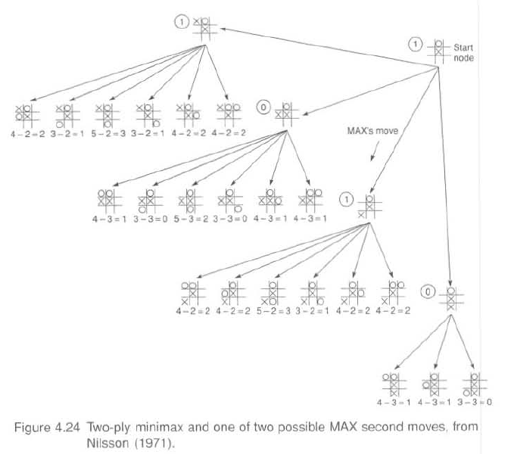

Slide 45
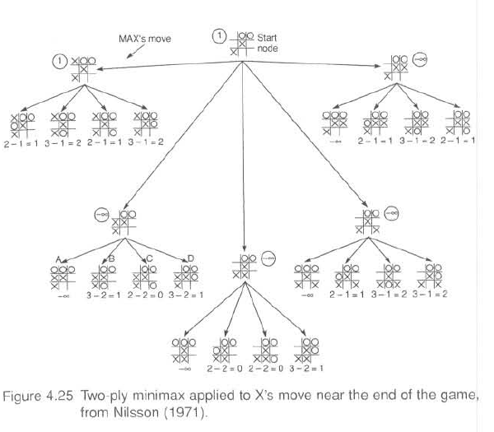

Slide 46
MinMax Algorithm #1

Slide 47
Support Functions:
1. MOVEGEN( Position , Player) Function-The plausible-move generator, which returns a list of nodes representing the moves that can be made by Player in Position [Children]. We call the two players MAX and MIN ; in a chess program, we might use the names BLACK and WHITE instead.
2. Evaluation Function: (Position , Player) -The evaluation function, which returns a number representing the
goodness of Position from the standpoint of Player.
Deep-Enough Function: Uses following Cutoff Characterization:
• Has one side won?
• How many ply have we already explored?
• How promising is this path?
• How much time is left?
• How stable is the configuration?
Output of the algorithm:
• The backed-up value of the path it chooses.
• The path itself. We return the entire path even though probably only the first element, representing the best move from the current position, is actually needed.

Slide 48
MINIMAX (CURRENT, 0 ,MAX)
if PLAYER-ONE is to move, or
MINIMAX (CURRENT, 0 ,MIN)
if PLAYER-TWO is to move.
Algorithm: MINIMAX(Position, Depth, Player)
1. If DEEP-ENOUGH(Position, Depth), then return the structure
VALUE = EVALUATION- FUNCTION (Position, Player);
PATH = nil
This indicates that there is no path from this node and that its value is that determined by the static evaluation function.
2. Otherwise, generate one more ply of the tree by calling the function MOVE-GEN(Position Player) and setting SUCCESSORS to the list it returns.
3. If SUCCESSORS is empty, then there are no moves to be made, so return the same structure that would have been returned if DEEP-ENOUGH had returned true.
4. If SUCCESSORS is not empty, then examine each element in turn and keep track of the best one. This is done as follows.
Initialize BEST-SCORE to the minimum value that Evaluation-Function can return. It will be updated to reflect the best score that can be achieved by an element of SUCCESSORS.
For each element SUCC of SUCCESSORS, do the following:
(a) Set RESULT-SUCC to
MINIMAX(SUCC, Depth + 1, OPPOSITE(Player))
This recursive call to MINIMAX will actually carry out the exploration of SUCCC.

Slide 49
(b) Set NEW-VALUE to - VALUE(RESULT-SUCC). This will cause it to reflect the merits of the
position from the opposite perspective from that of the next lower Ievel.
(c) If NEW-VALUE> BEST-SCORE, then we have found a successor that is better than any that
have been examined so far. Record this by doing the following:
(i) Set BEST-SCORE to NEW-VALUE.
(ii) The best-known path is now from CURRENT to SUCC and then on to the appropriate path down from SUCC as determined by the recursive call to MINIMAX. So set BEST-PATH to the result of attaching SUCC to the front of PATH(RESULT-SUCC).
5. Now that all the successors have been examined, we know the value of Position as well as which path to take from it. So return the structure
VALUE = BEST-SCORE
PATH = BEST-PATH

Slide 50
Reverting f Values at terminal node, if it is in Min’s term
If the terminal node is in the turn of the Min, You must reverse th F-value at the node before using the algorithm.

Slide 51
Example and Trace of MinMax Algorithm

Slide 53
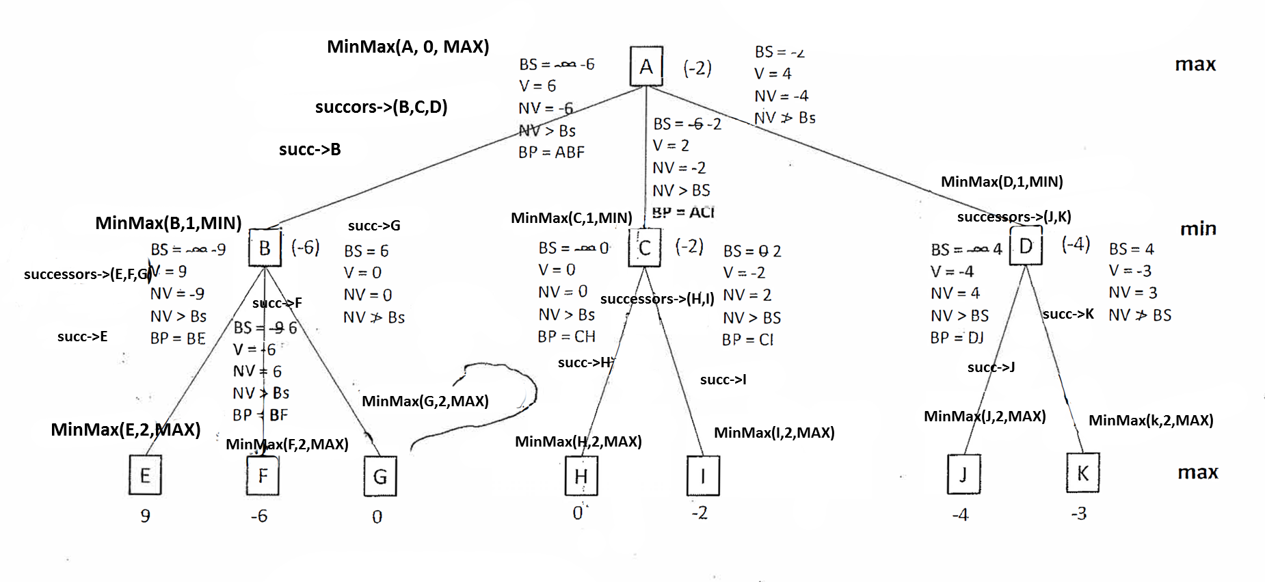
MinMax(A, 0, MAX)
Succors->(B,C,D)
succ->B
MinMax(B, 1, MIN)
successors->(E,F,G)
succ->E
succ->H
succ->I
succ->J

Slide 54
Results
Best Path = ACI
Best Score at the root is: -2

Slide 55
Intelligent Systems Version #5 Alpha-Beta Search
The idea for alpha-beta search is simple: rather than searching the entire space to the ply depth, alpha-beta search proceeds in a depth-first fashion. Two values, called alpha and beta, are created during the search. The alpha value, associated with MAX nodes, can never decrease, and the beta value, associated with MIN nodes, can never increase. Suppose a MAX node's alpha value is 6. Then MAX need not consider any backed-up value less than or equal to 6 that is associated with any MIN node below It. Alpha is the worst that MAX can "score" given that MIN will also do its "best." Similarly, if MIN has beta value 6, it does not need to consider any MAX node below that has a value of 6 or more.

Slide 56
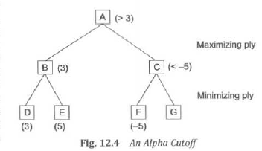

Slide 57
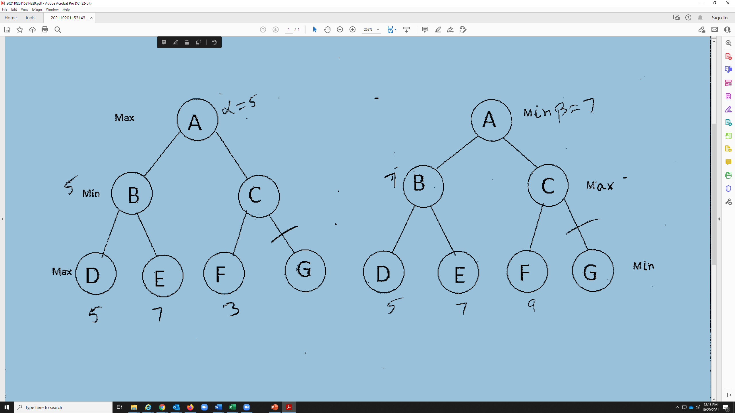

Slide 58
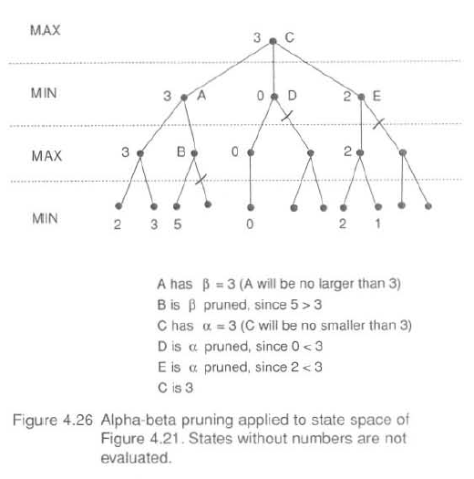

Slide 59
MinMax-A-B Algorithm #1

Slide 60
MINIMAX-A-B(CURRENT,0, Max, Maximum value Evaluation Function can compute, Minimum value Evaluation Function can compute)
These initial values for Use-Thresh and Pass-Thresh represent the worst values that each side could achieve.
Algorithm: MINIMAX-A-B (Position, Depth, Player, Use-Thresh, Pass Thresh)
If DEEF-ENOUGH(Position, Depth) then return the structure
VALUE= Evaluation Function (Position, Player);
PATH=nil
2. Otherwise, generate one more ply of the tree by calling the function
MOVE-GEN (Position, Player) and setting SUCCESSORS to the list it returns.
3. If SUCCESSORS is empty, there are no moves to be made: return the same structure that would have been returned if DEEP-ENOUGH had returned TRUE.

Slide 61
4. If SUCCESSORS is not empty, then go through it, examining each element and keeping track of the best one. This is done as follows,
For each element SUCC of SUCCESSORS:
(a) Set RESULT-SUCC to
MINIMAX-A-B (SUCC, Depth+ 1, OPPOSITE (Player), -Pass-Thresh,-Use -Thresh).
(b) Set NEW-VALUE to -VALUE (RESULT-SUCC).
(c) If NEW-VALUE> Pass-Thresh, then we have found a successor that is better than any we have examined so far. Record this by doing the following,
i. Set Pass-Thresh to NEW-VALUE.
ii. The best-known path is now from CURRENT to SUCC and then on to the appropriate path from SUCC as determined by the recursive call to MINIMAX-A-B. So set BEST-PATH to the result of attaching SUCC to the front of PATH (RESULT-SUCC).
(d) If Pass-Thresh (reflecting the current best value) is not better than Use-Thresh, then we should stop examining this branch. But both thresholds and values have been inverted. So, if Pass-Thresh>= Use­ Thresh, then return immediately with the value
VALUE= Pass-Thresh
PATH= BEST-PATH
5. Return the structure
VALUE= Pass-Thresh
PATH= BEST-PATH

Slide 62
Example and Trace of MinMax- A-B Algorithm

Slide 63
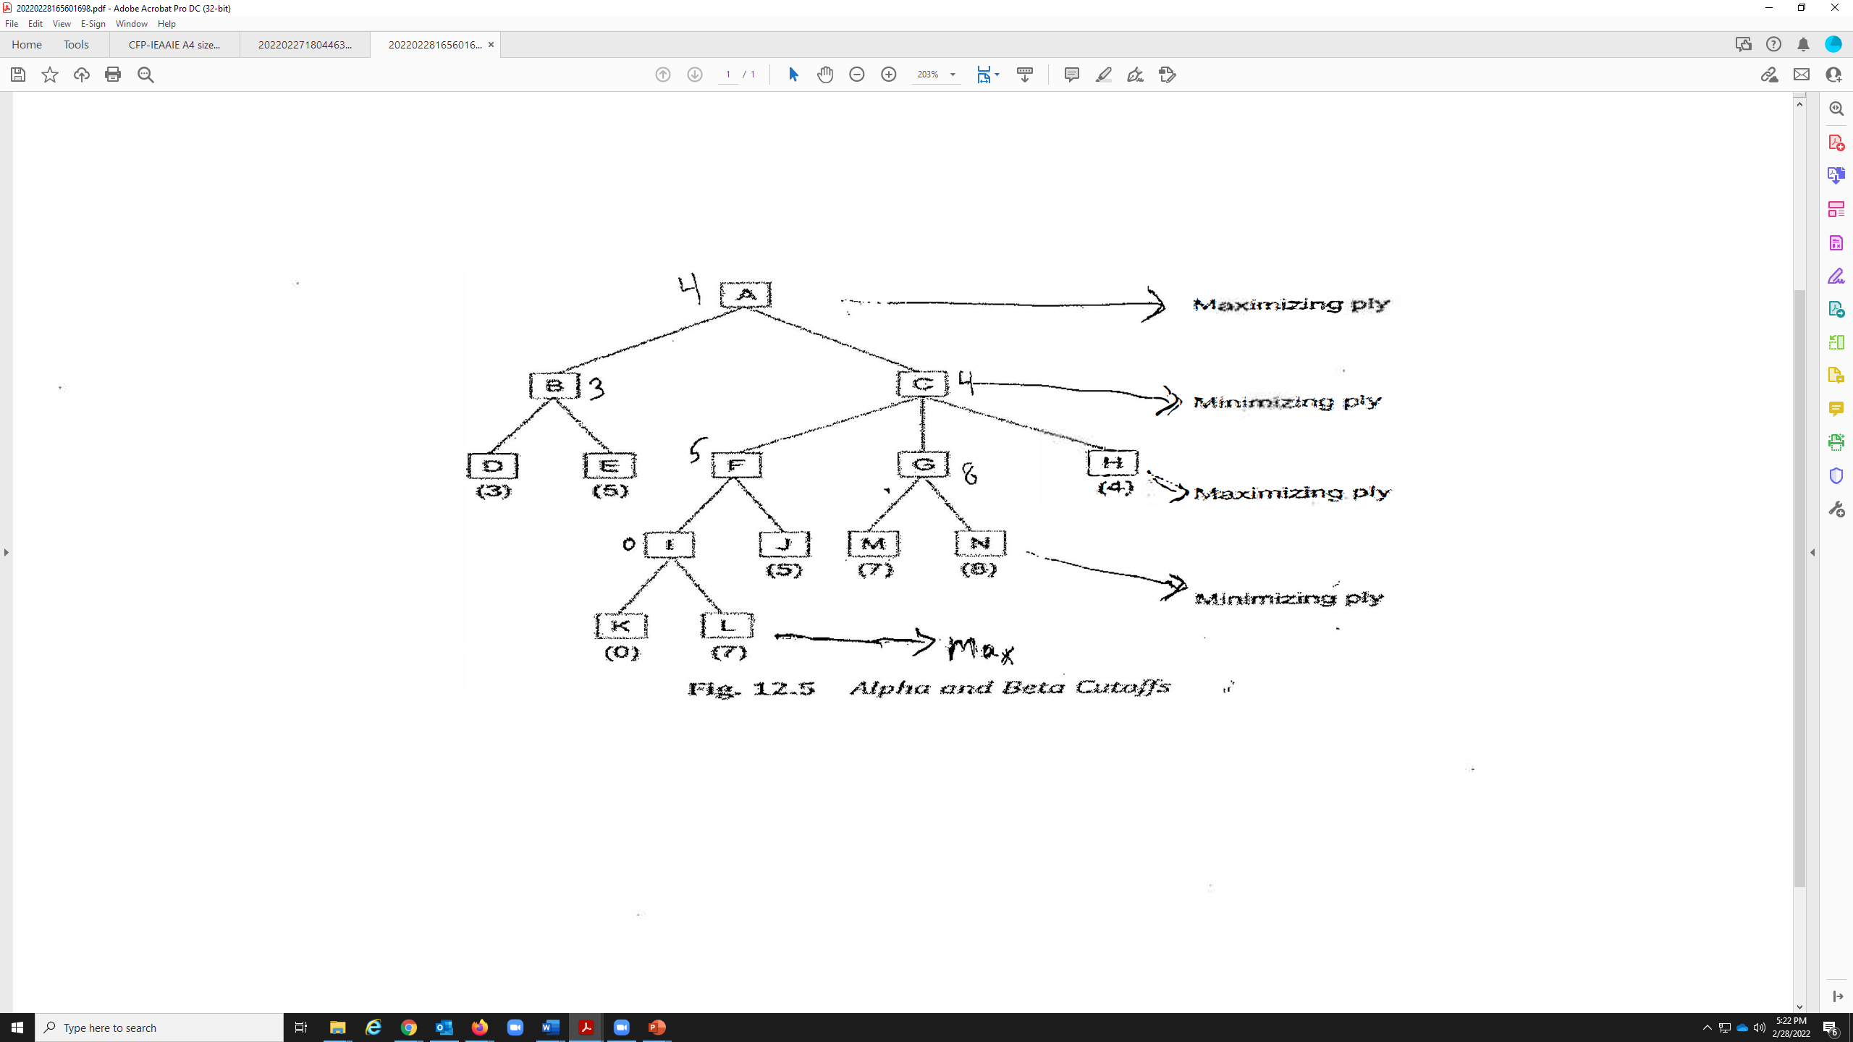

Slide 64
Reverting f Values at terminal node, if it is in Min’s term
If the terminal node is in the turn of the Min, You must reverse th F-value at the node before using the algorithm.

Slide 65
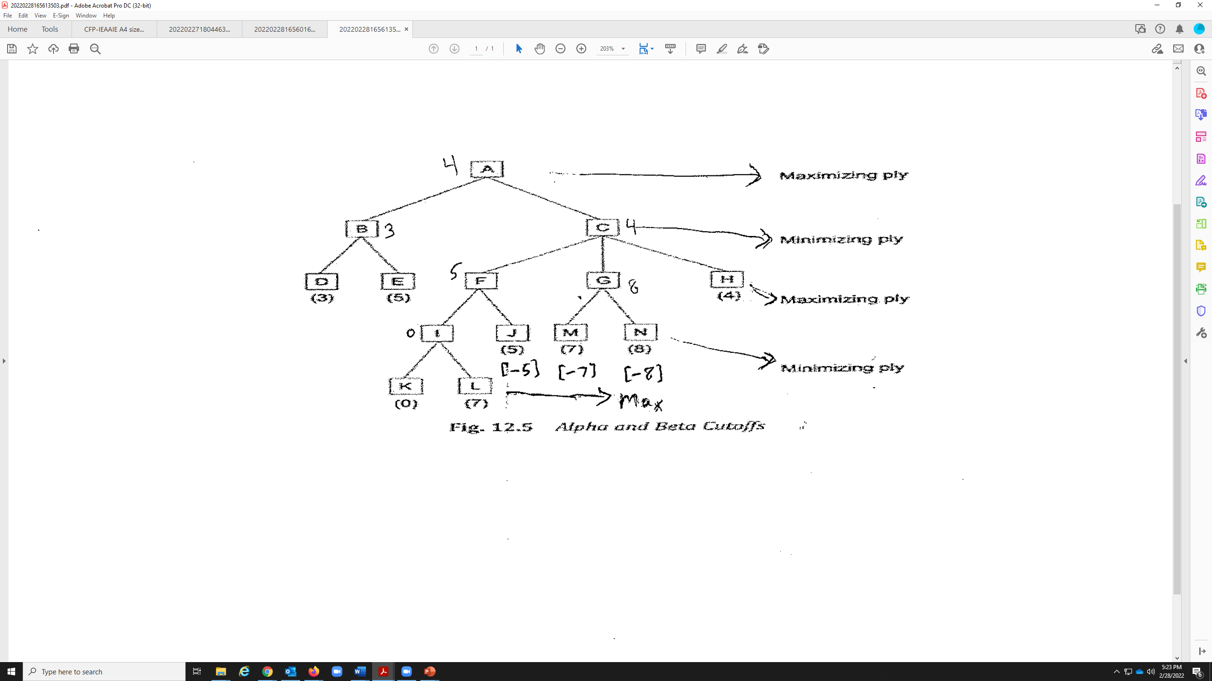

Slide 66
Terms used in the TREE
CPT -> Change Pass Threshold
NCPT -> No Change in Pass Threshold
NPr -> No Pruning
Pr/P -> Prune

Slide 67
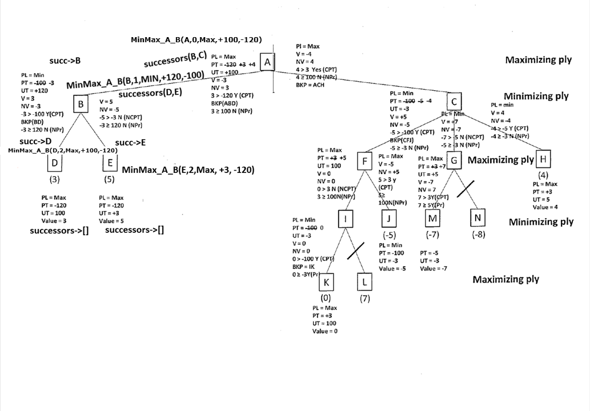

Slide 68
Results
Best Path = ACH
Best Score at the root is: 4

